Slide 1

Technology Exploration and Social Innovation-1
CO2/O2 LEVEL INDICATOR IN CARS
Under the esteemed guidance of
Mr. Nagaraja Kumar Pateti, Assistant Professor
Mrs. M. Nagageetha, Assistant Professor
DEPARTMENT OF FRESHMAN ENGINEERING
CMR INSTITUTE OF TECHNOLOGY
UGC- AUTONOMOUS
APPROVED BY AICTE, ACCREDITED BY NAAC WITH ‘A’ GRADE,ACCREDITED BY NBA, NEW DELHI
KANDLAKOYA MEDCHAL ROAD HYDERABAD-501401

Slide 2
PRESENTED BY
BATCH NO C5
P. JAYASREE (19R01A04F9)
M. SHIRISHA (19R01A04E6)
TANU PRIYA (19R01A04H2)
S. JAIPAL (19R01A04G8)
M. RAJASHEKAR (19R01A04F1)
S. SAI PRANAY (19R01A04G9)
Technology Exploration and Social Innovation -1 CMR Institute of Technology

Slide 3
CONTENTS
PROBLEM DEFINITION
LITERATURE SURVEY
PROPOSED IDEA
METHODOLOGY
WORKING PRINCIPLE
ADVANTAGES
APPLICATIONS
CONCLUSION
REFERENCES
Technology Exploration and Social Innovation -1 CMR Institute of Technology

Slide 4
PROBLEM DEFINITION
All the students thought about this idea after reading and hearing news about accidental deaths in cars due to suffocation.
Technology Exploration and Social Innovation -1 CMR Institute of Technology

Slide 5
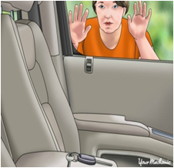
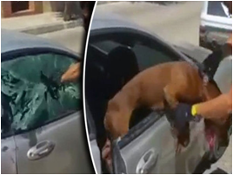
PROPOSED IDEA
To detect levels of oxygen/ carbon dioxide and open windows when oxygen level drops or carbon dioxide level rises, thereby preventing accidental deaths of children or pets locked inside the car.
Technology Exploration and Social Innovation -1 CMR Institute of Technology

Slide 6
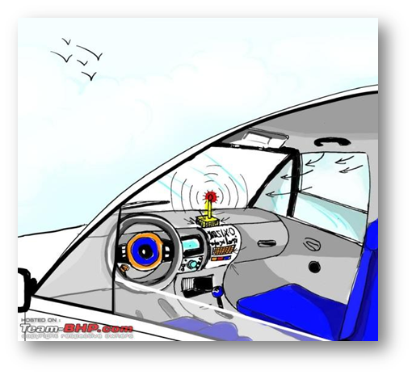
METHODOLOGY
Detecting levels of oxygen/ carbon dioxide and open windows when oxygen level drops or carbon dioxide level rises

Slide 7
COMPONENTS
ARDUINO
BUZZER
BREAD BOARD
BLUETOOTH MODULE
LED
MQ-2 SENSOR
PIR SENSOR
POWER WINDOWS
DC BATTERY
CONNECTING WIRES
Technology Exploration and Social Innovation -1 CMR Institute of Technology

Slide 8
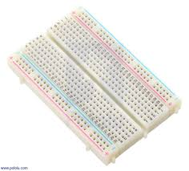
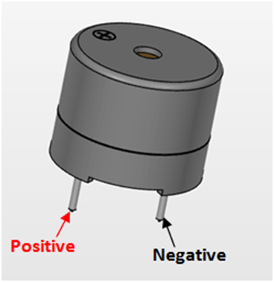
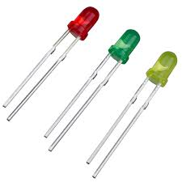
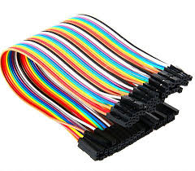
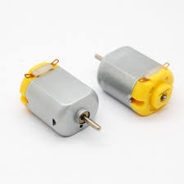
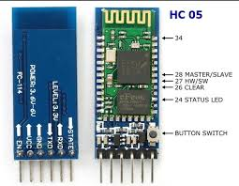
BUZZER BREAD BOARD LED
BLUETOOTH MODULE CONNECTING WIRES DC MOTOR

Slide 9
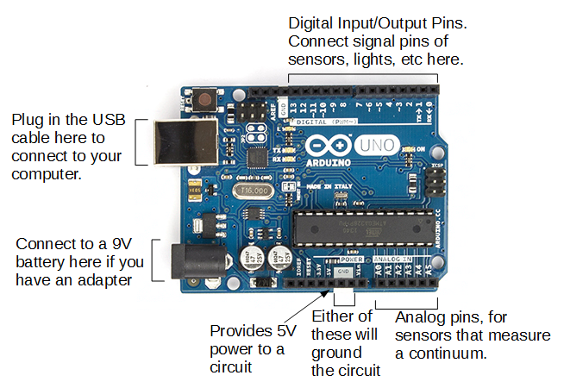
ARDUINO
Technology Exploration and Social Innovation -1 CMR Institute of Technology

Slide 10
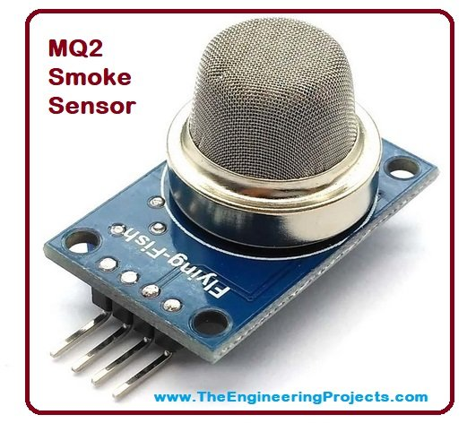
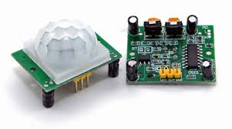
MQ-2 SENSOR
PIR SENSOR

Slide 11
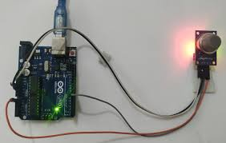
CONNECTIONS CONNECTIONS FOR MQ2
Arduino MQ2
AO A0
5V VCC
GND GND

Slide 12
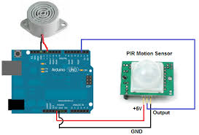
CONNECTIONS FOR PIR

Slide 13
WORKING PRINCIPLE
When the carbon dioxide level increases inside the car the oxygen/carbon dioxide level detector device would get activated and the windows of the car will open automatically in order to prevent the suffocation.
Technology Exploration and Social Innovation -1 CMR Institute of Technology

Slide 14
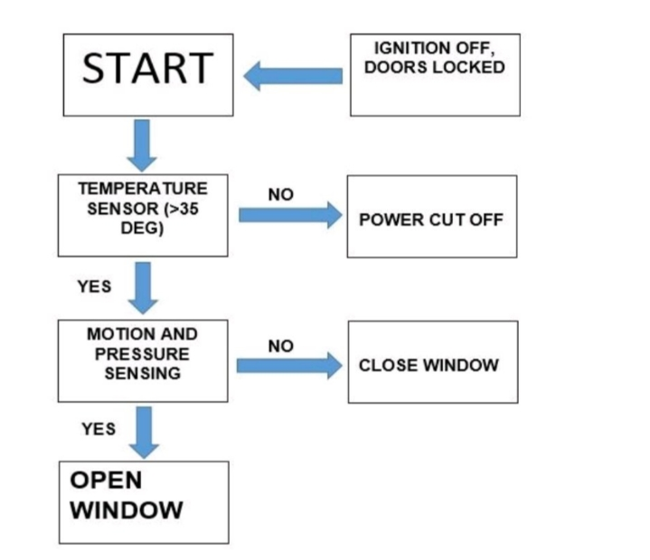

Slide 15
ADVANTAGES
It will help in avoiding deaths due to suffocation inside the car.
It would help to maintain the oxygen and carbon dioxide level in car
This will help in enhancing the technology of cars.
To prevent high co2 level in police vehicle.
Technology Exploration and Social Innovation -1 CMR Institute of Technology

Slide 16
APPLICATIONS
We can reduce death causing by the toxic levels in cars for some extent.
It indicates indoor air quality.
Co2 sensors can be used to monitor the quality of air.
Technology Exploration and Social Innovation -1 CMR Institute of Technology

Slide 17
CONCLUSION
By using this device we can prevent the accidental deaths in the cars which generally causes due to suffocation.
Technology Exploration and Social Innovation -1 CMR Institute of Technology

Slide 18
REFERENCES
https://www.irjet.net/archives/V6/i3/IRJET-V6I3623.pdf
http://www.ijtre.com/images/scripts/2017040974.pdf
Technology Exploration and Social Innovation -1 CMR Institute of Technology

Slide 19


Technology Exploration and Social Innovation -1 CMR Institute of Technology

